Slide 1
Algorithmic Trading Model for BTC/USDT Market
Kharagpur Data Science Hackathon 2024
Team:
Shubham Sharma
Harsh Singh
Aakashdeep Srivastava
Thejas Elandassery

Slide 2
Introduction
Overview of problem statement and significance of developing algorithmic trading models for BTC/USDT market.
Emphasis on machine learning and statistical modeling in trading.
Unlocking the potential of ML-based algorithmic trading.

Slide 3
Problem Description
Tasks include data acquisition, preprocessing, model design, backtesting, risk management, and optimization.
Focus on the dynamics of the BTC/USDT market.
Challenges in cryptocurrency market analysis and strategy development.

Slide 4
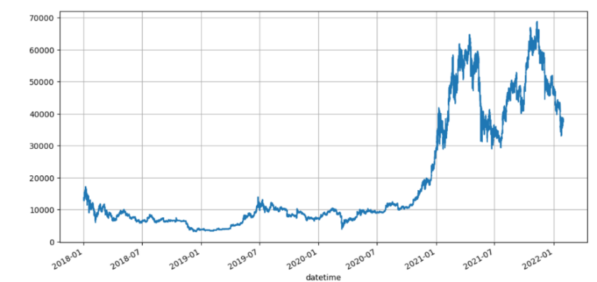
Data and Resources
Availability of historical data for BTC/USDT from Jan 1, 2018, to Jan 31, 2022.
Use of public cryptocurrency market data sources and API services.
Employment of simulated data for analysis and model testing.

Slide 5
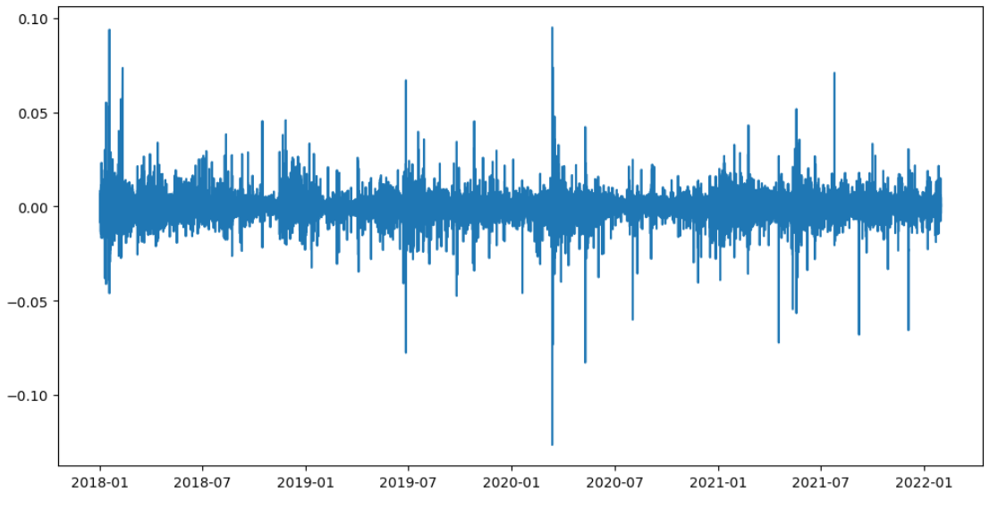
Methodology: Time Series Analysis
Time series analysis of BTC/USDT closing prices (Jan 1, 2018 - Jan 31, 2022).
Lag plots showing the correlation between a time series and its lagged values.
KPSS test suggests non-stationarity; preprocessing to achieve stationarity.

Slide 6
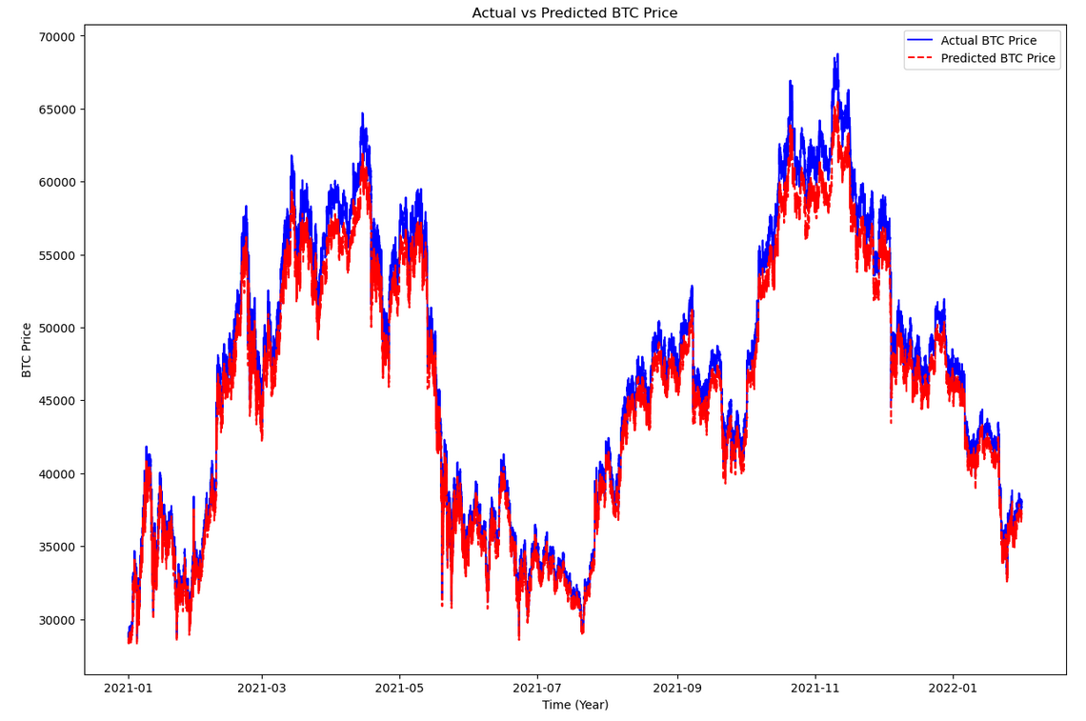
Models: Time Series and Machine Learning
Utilization of simple and exponential moving averages for trend analysis.
LSTM networks to capture long-term dependencies in price and trading volume.
GARCH models to assess and manage BTC/USDT market volatility.

Slide 7

Performance and Conclusion
Max drawdown of the model: 10%
Sharpe ratio of the model: 0.00174
Net profit exceeding benchmark return: 0%
Risk-reward ratio and max duration time of single trade: 1.01
Max Duration Time of Single Trade of the Model: 0.116 days

